Slide 1


Slide 2


Introduction
Drive business decision-making
Maximize efficiency in business processes
Realize improved financial performance
Why analyze our data?
Data Analysis I 2021 I

Slide 3
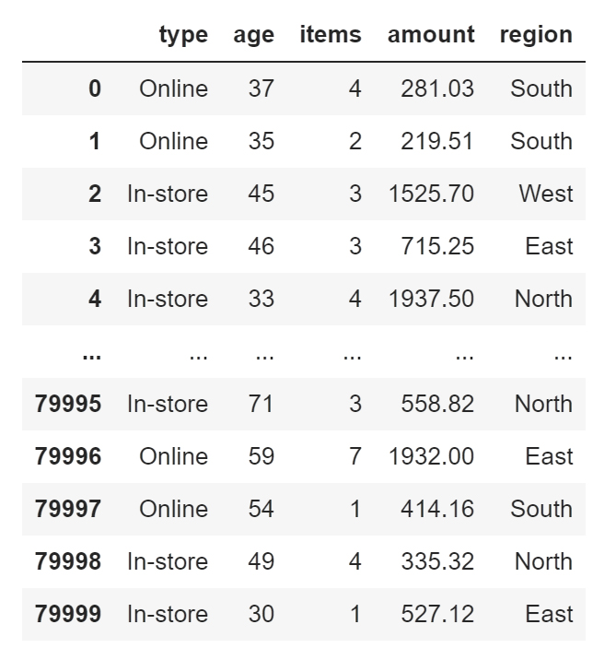
Overview
Our dataset includes:
Data from 80,000 transactions captured from the launch of our eCommerce site
Information about important buying and demographic variables, such as age, region of purchase, amount of purchase, number of items purchased
Data Analysis I 2021 I

Slide 4
Buying Pattern Analysis
1. Do customers in different regions spend more per transaction?
Which regions spend the most/least?

Slide 5
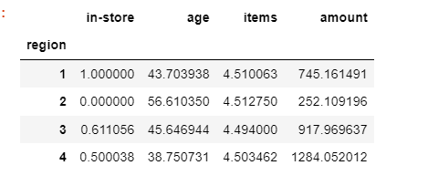
1a. Do customers in different regions spend more per transaction? 1b. Which regions spend the most/least?
Customer Buying Patterns Analysis
Stacked column:
Amount per transaction and items per transaction data was analyzed from 4 different regions, North (1), South (2), East (3), and West (4).
The analyzed data shows that the West region spends the most overall per transaction.
The region that spent the less per transaction was the South region.
We can proof this by obtaining each regions average, $252.00 being the lowest for the South region and $1284.00 being the highest for the West region.
Data Analysis I 2021 I

Slide 6
Buying Pattern Analysis
2. Is there a relationship between number of items purchased and amount spent?

Slide 7
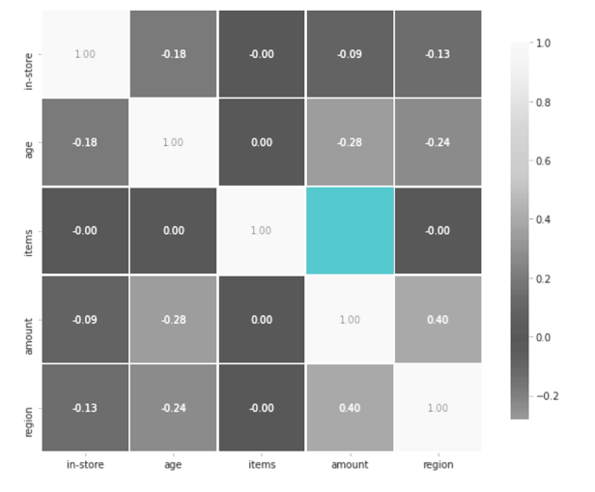
2. Is there a relationship between number of items purchased and amount spent?
Customer Buying Patterns Analysis
Correlation heat map:
Correlation shows the strength of a relationship between two variables.
In a heat map we can see this by 1 meaning there is a connection and anything less than that means the connection decreases.
By getting the correlation from the data set, we can see that there is no significant relationship between items purchased and amount spent in any of the regions.
0.00
Data Analysis I 2021 I

Slide 8
Customer Demographics Analysis
3. Are there differences in the age of customers between regions?
If so, can we predict the age of a customer in a region based on other demographic data?

Slide 9
3a. Are there differences in the age of customers between regions?
Customer Demographics Analysis
There are differences in the age of customers between regions.
North Region: age range is 19-77
South Region: age range is 28-85
East Region: age range is 18-74
West Region: age range is 18-63
Data Analysis I 2021 I

Slide 10
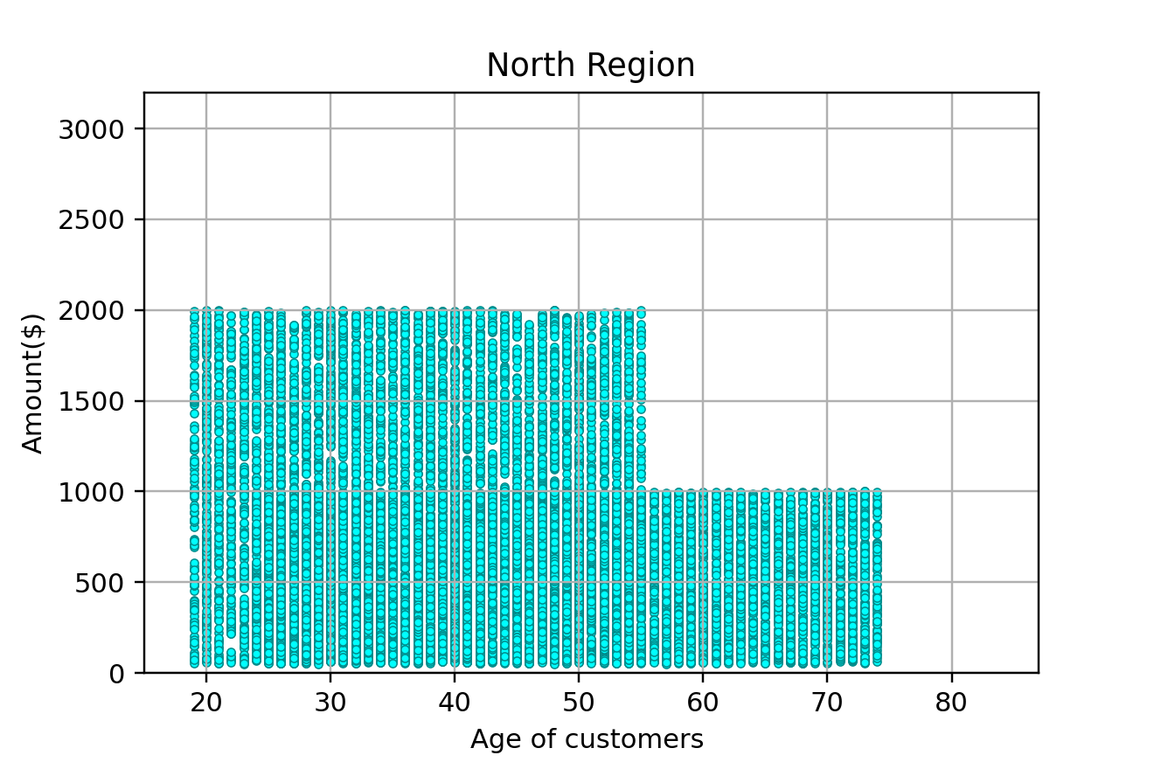
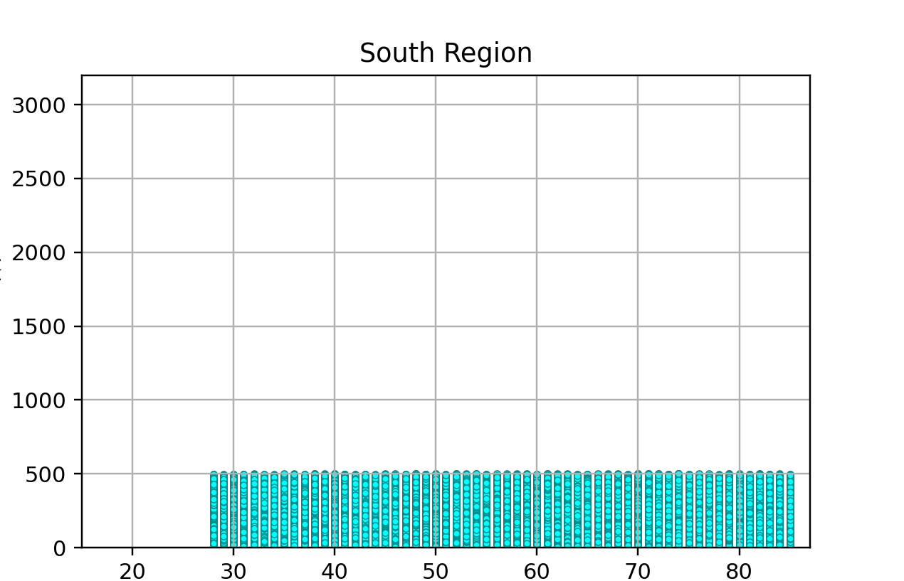
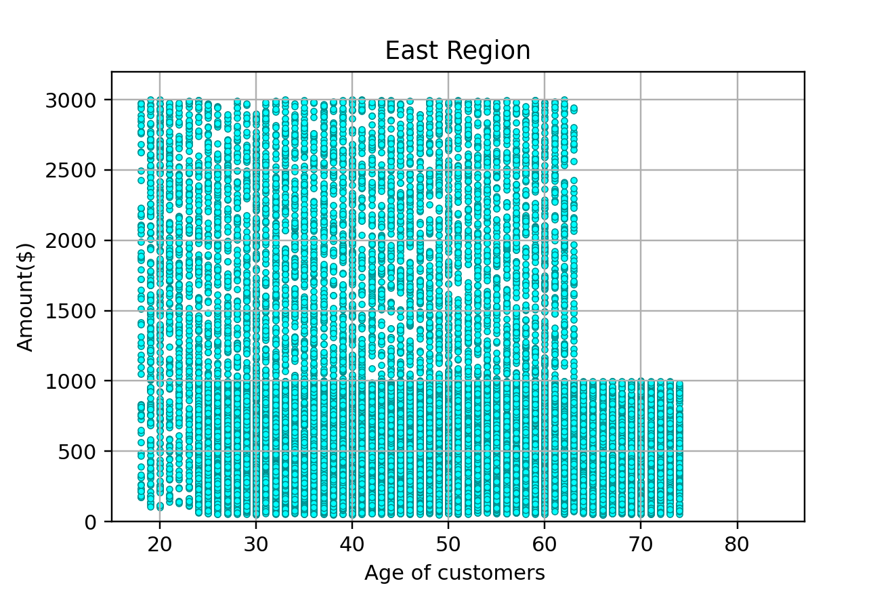
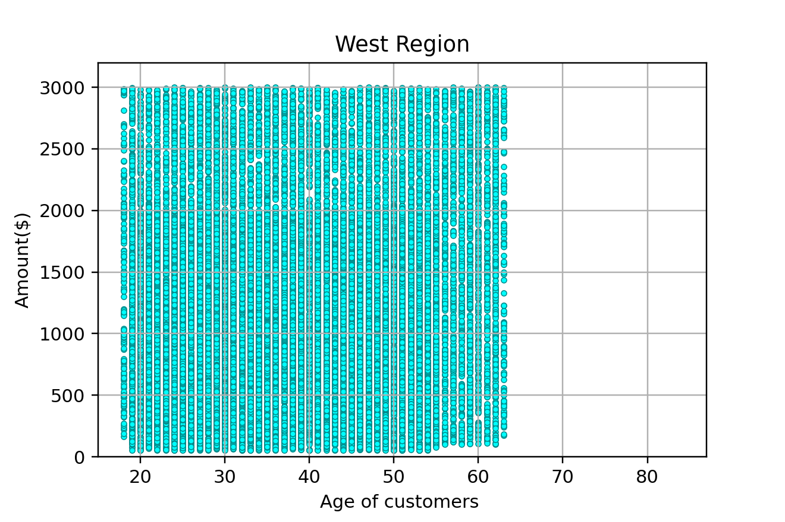
3b. If so, can we predict the age of a customer in a region based on other demographic data?
Customer Demographics Analysis
If we only divided the age of customers into two groups, we could predict the customers age in some regions.
Age group | Accuracy
15-20, 21-30, 31-40, 41-50, 51-60, 61-70, 71-85 | 24%
15-30, 31-45, 46-60, 61-85 | 31%
15-40, 41-60, 61-85 | 48%
15-30, 31-60, 61-85 | 62%
15-60, 61-85 | 81%
Region | Age Group | Accuracy
North | 15-55, 56-85 | 82%
South | 15-60, 61-85 | 56%
East | 15-63, 64-85 | 88%
West | 15-55, 56-85 | 92%
Data Analysis I 2021 I

Slide 11
Customer Demographics Analysis
4. Is there any correlation between age of a customer and if the transaction was made online or in the store? Do any other factors predict if a customer will buy online or in our stores?

Slide 12
4a. Is there any correlation between age of a customer and if the transaction was made online or in the store?
Customer Demographics Analysis
Both correlation heatmap and histogram shows a slightly negative correlation between age of a customer and if the transaction was made online or in the store.
In the correlation matrix, it indicates -0.18 between age of a customer and in-store. -0.18 here means as age increases, the in-store purchase decreased.
18-33 age group - around 40% - online.
34-49 age group - around 40% - online.
50-64 age group - around 50% - online.
64+ age group - around 65% - online.
Data Analysis I 2021 I

Slide 13
4b. Do any other factors predict if a customer will buy online or in our stores?
Customer Demographics Analysis
Prediction Chart of Place of Transaction
Demographic Factors |  |  | Place of Transaction
Region | Amount | Age | In-store | Online
North |  |  | Yes
South |  |  |  | Yes
East | up to $1000 | <=23 |  | Yes
 |  | >=63 | Yes
 | $1000-$2000 |  |  | Yes
 | $2000+ |  |  | Yes
West | up to $1000 | <=18 |  | Yes
 |  | >=55 |  | Yes
 | $1000-$2000 | <=18 |  | Yes
 |  | >=55 |  | Yes
 | $2000+ |  |  | Yes
Region, transaction amount and age are three factors that predict if a customer will buy online or in store. Region is the most correlated factor to the place of transaction.
All of customers from the north region made their purchases in-store while all of customers from south made their purchase online.
All purchase amount above $2,000 are made online.
Data Analysis I 2021 I

Slide 14

Where can data analysis take our company?
Possibilities
Predict operations costs over time
Recruit and retain the best employees for our business
Analyze losses and what can be done to minimize them
Data Analysis I 2021 I

Slide 15
Blackwell's eCommerce Team
Thank You
Kate Koebbe Wanyun Ho Alma Martinez Yao Lin

